Slide 1
Relationships between educational outcomes and cultural factors
(A work in progress)
Andrew McCartney

Slide 2

The inspiration for this project:
“Preschool In Three Cultures” project (1980s)
“revisited” (mid 2000s)
Series of videos and interviews with preschool teachers and parents in China, Japan, and Hawaii

Slide 3

The inspiration for this project:
One key finding: Teachers in China preferred larger pre-school class sizes (about 40 kids) whereas teachers in USA preferred smaller classes—as small as possible.
Is this linked to the difference in individualism and collectivism between those two societies?
Can this be addressed quantitatively?

Slide 4
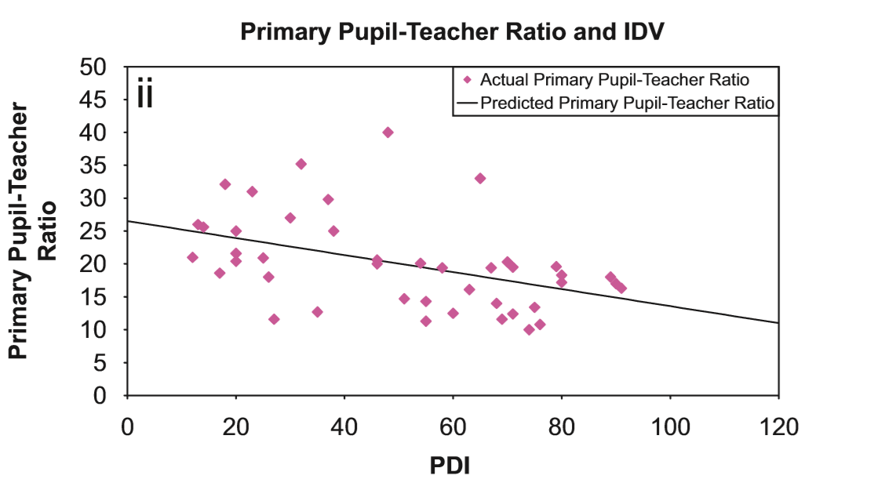
The inspiration for this project:
Yes, it can:
Oh no, I was just a single decade too late!
Cheung, H. Y., & Chan, A. W. (2008). Relationships amongst cultural dimensions, educational expenditure and class size of different nations. International Journal of Educational Development, 28(6), 698-707.
N.B. x-label should be “IDV” not “PDI”

Slide 5
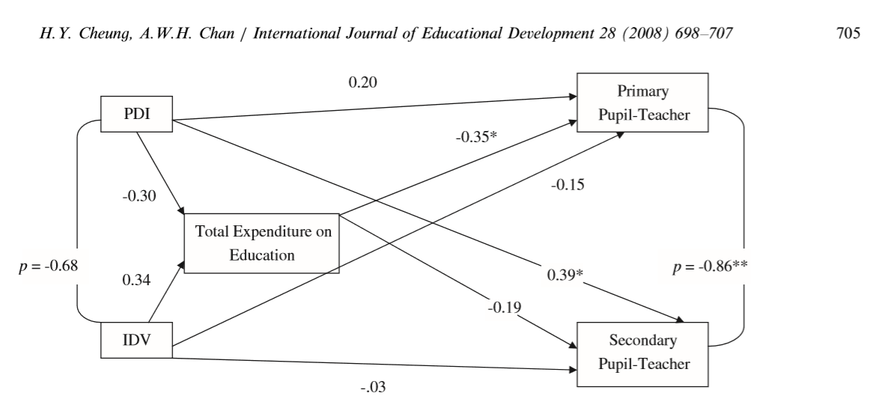
The inspiration for this project:
Yes, it can:
Cheung and chan SEM Here

Slide 6
The inspiration for this project:
Okay, but what else can we learn about the relationships between educational systems and policies and cultural dimensions?
First? What are the cultural dimensions? Where did they come from?

Slide 7
The Data: (Hofstede’s Dimensions)
Power Distance
Masc vs. Femininity
Long-term vs. Short-term
Individualism vs. Collectivism
Uncertainty Avoidance
Indulgence vs. Restraint
Driven by I-O psych in the 1960s.
Used factor-analysis on surveys for IBM employees (N=117,000!)
Updated not just for countries but also sub- and supra-national regions (but our focus is only on nations…mostly)
Data easily available via:
http://geerthofstede.com/research-and-vsm/dimension-data-matrix/

Slide 8
Add a Slide Title - 1
Is this just a meta-level test of the UA of the researchers?

Slide 9
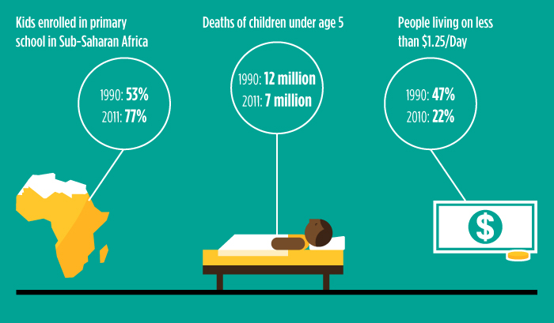
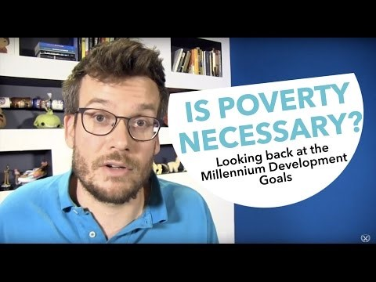
The Data: (Development Goals)
Millennium Development Goals: 1990-2015
Sustainable Development goals: 2015-2030
May seem utopian, naive, or overly-idealistic.
Here’s the thing: they work!
Photo via: https://www.gatesnotes.com/Development/MDGs-Dream-with-a-Deadline

Slide 10


Slide 11
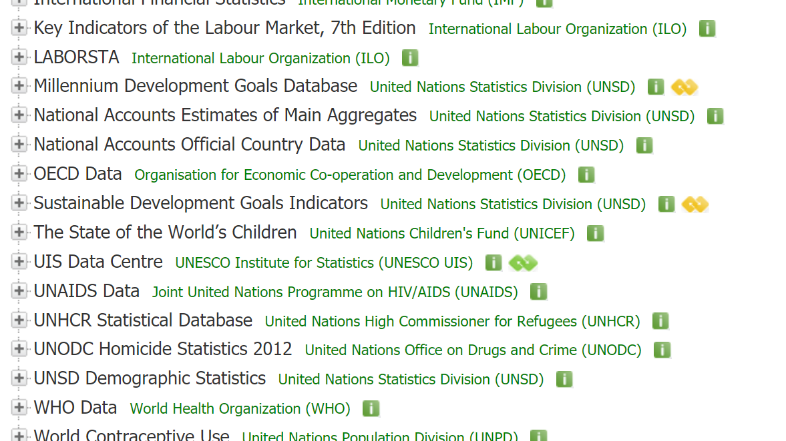
The Data: (Development Goals)
Okay but how are these tracked? And where do you get the data?
Enter: UNDATA Explorer!

Slide 12
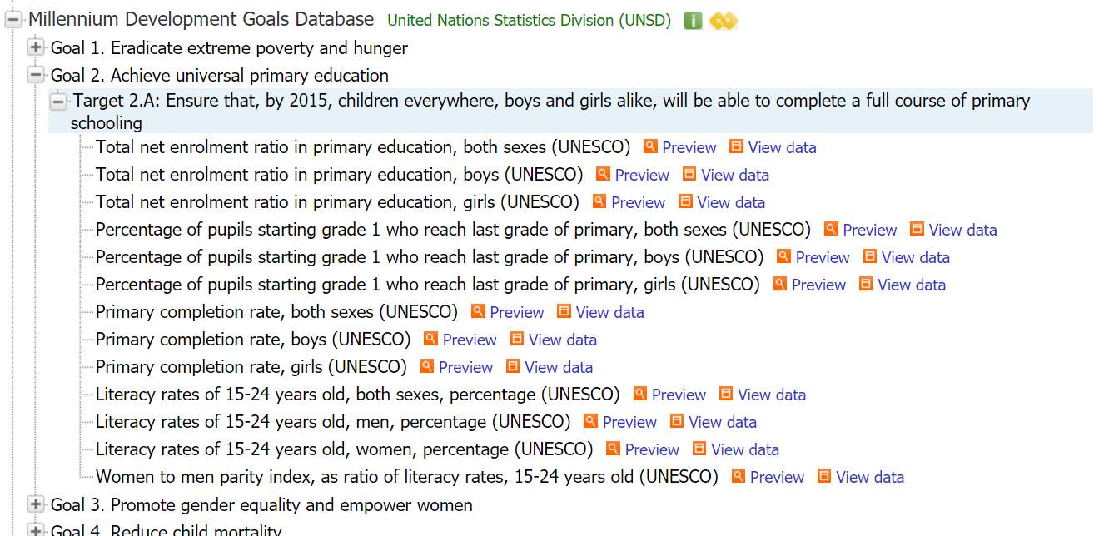

Slide 13
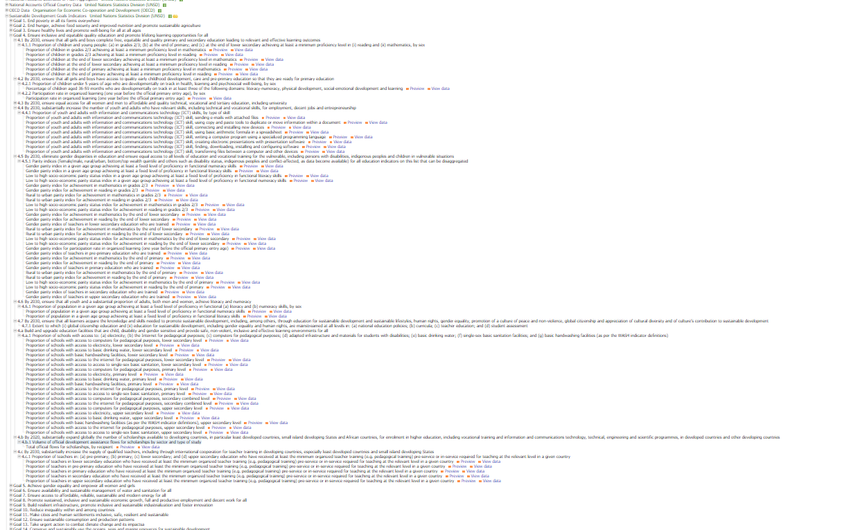
…These Ones

Slide 14
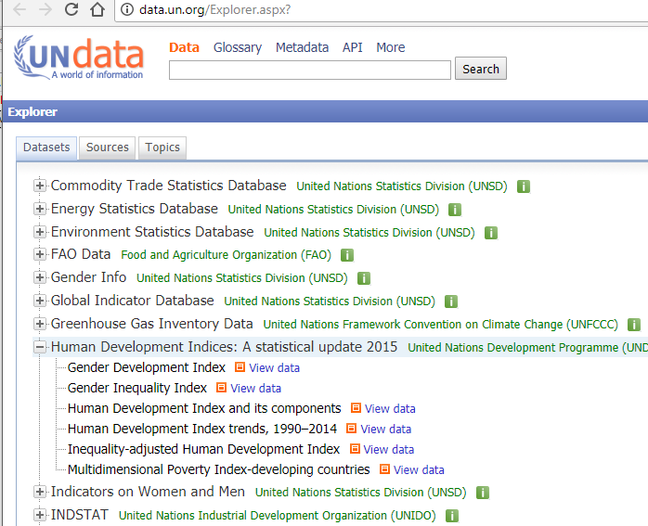
The Data: (Human Development)
Inequality Adjusted Human Development Index
(IHDI)
…and its components
What’s the adjustment?
“discounting each dimensions average value according to its level of inequality” (UNDP)
This one
http://hdr.undp.org/en/content/inequality-adjusted-human-development-index-ihdi

Slide 15
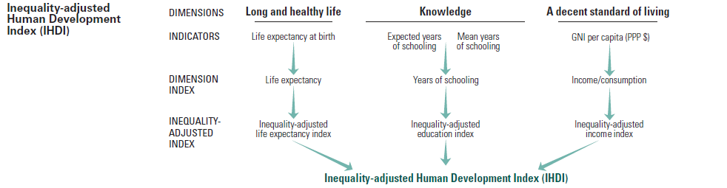
Beware multicollinearity
http://hdr.undp.org/en/content/inequality-adjusted-human-development-index-ihdi

Slide 16
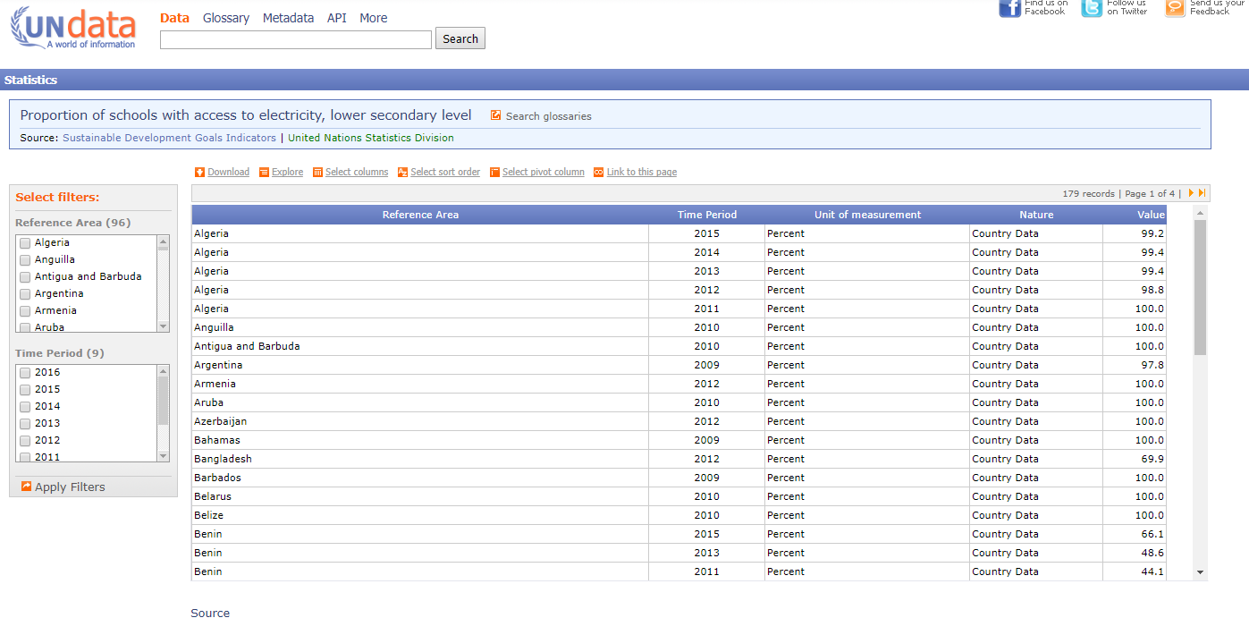
What do the data frames look like?

Slide 17
The Data (all told)
First Data Frame:
Hofstede’s cultural dimensions: country-level data
Second “Data Frame”
Part A: MDGS (10 frames)
Country by year
Part B: SDGS (31 frames)
Country by year, but
10 are country-by-year-by-sex
Third “Data Frame”
IHDI (country level)
The task, then, is to:
widen the 10 SDG country-by-year-by-sex data frames
merge them together
merge together the 10 MDG
Merge the MDG & SDG
One-to-many merge the IHDI
One-to-many merge the Hofstede
Done!

Slide 18
Loops and other problems:
An additional, heretofore unmentioned, problem: downloading the SDG/MDG data yields filenames such as:
UNdata_Export_20171204_052921541.csv
Green is the date; blue is the time (GMT)
2017, December 4th, at 11:29:21 and 541 milliseconds pm.
As such, I renamed these with integer values after “export_” so that I could loop through them as 1(1)n
In so doing, it was necessary to manually re-label the variable names for the 41 variables because these integers were not systematically assigned.
Before submitting the final, I plan to systematically assign these numbers, then use number-correspondences to assign the variable names by using a local.

Slide 19
Loops and other problems:
Loop through and replace the .csv with .dta
//starting with the MDG data sets
forvalues i=1(1)10 {
import delimited "UNdata_Export_MDG`i'.csv", clear
save UNdata_Export_MDG`i', replace
}
// And then doing the same for the SDG Data sets:
forvalues i=1(1)31 {
import delimited "UNdata_Export_SDG`i'.csv", clear
save UNdata_Export_SDG`i', replace
}

Slide 20
Loops and other problems:
BUT!
We can’t merge, because the variable names are too similar:
totalnetenrolmentratioinprimarye
totalnetenrolmentratioinprimarye
use "UNdata_Export_MDG1", clear
rename totalnetenrolmentratioinprimary pr_enr_both_sex
save UNdata_Export_MDG1_n, replace
use "UNdata_Export_MDG2", clear
rename totalnetenrolmentratioinprimarye pr_enr_boys
save UNdata_Export_MDG2_n, replace
use "UNdata_Export_MDG3", clear
rename totalnetenrolmentratioinprimarye pr_en_girls
save UNdata_Export_MDG3_n, replace
use "UNdata_Export_MDG4", clear
rename primarycompletionratebothsexes pr_comp_both_sex
save UNdata_Export_MDG4_n, replace
// you get the idea…

Slide 21
Loops and other problems:
forvalues i=1(1)31 {
use "UNdata_Export_SDG`i'", clear
rename referencearea countryorarea
rename timeperiod year
replace countryorarea = "Korea, Republic of" if countryorarea == "Republic of Korea"
replace countryorarea = "Czech Republic" if countryorarea == "Czechia"
replace countryorarea = "Bolivia" if countryorarea == "Bolivia (Plurinational State of)"
replace countryorarea = "Micronesia, Federated States of" if countryorarea == "Micronesia (Federated States of)"
replace countryorarea = "United Kingdom" if countryorarea == "United Kingdom of Great Britain and Northern Ireland"
replace countryorarea = "United States" if countryorarea == "United States of America"
replace countryorarea = "Venezuela" if countryorarea == "Venezuela (Bolivarian Republic of)"
replace countryorarea = "Cape Verde" if countryorarea == "Cabo Verde"
save UNdata_Export_SDG`i'_m, replace
}
Country-IDs never generated by UN, so country names must be used to identify, but these aren’t stable and are inconsistent across the MDG and SDG data sets.

Slide 22
Loops and other problems:
Loop-to-merge
// Whew! That was a pain. Okay let's merge 'em now, shall we?
use "UNdata_Export_SDG1_n", clear
forvalues i=2(1)31 {
merge 1:1 countryorarea year using UNdata_Export_SDG`i'_n
drop _merge
}
save UNdata_Export_SDG_merged, replace
use UNdata_Export_MDG_merged, replace
merge 1:1 countryorarea year using UNdata_Export_SDG_merged
sort countryorarea year // ah much better.
browse
drop _merge
save UNdata_MDG_SDG, replace

Slide 23
Loops and other problems:
IHDI data set has same issues: rename all variables, replace country names, then save and merge.
// for example:
rename ïcountry countryorarea
replace countryorarea = "China, Hong Kong Special Administrative Region" if countryorarea == "Hong Kong, China (SAR)"

Slide 24
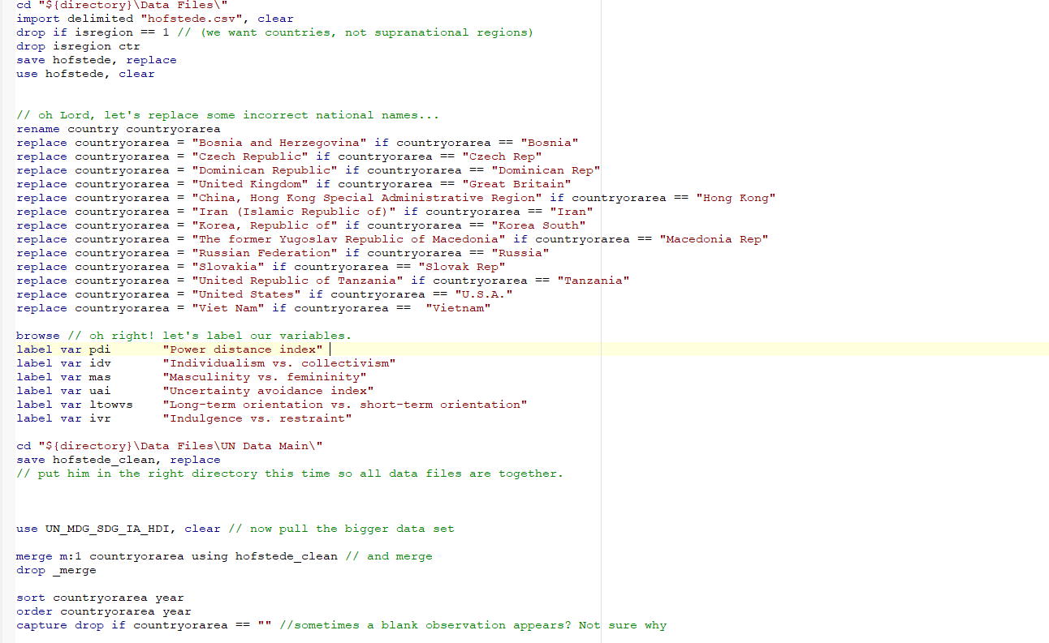
Loops and other problems:
Hofstede: same story.
Drop regions,
replace country names,
label variables,
save, then merge.

Slide 25
Okay, but did I learn anything?
Well, here’s one first hypothesis to test:
Power-Distance refers to the general level of inequality that is socially expected by a country.
How does it relate to our Inequality-adjusted indices?
Income, in this example
The idea being, is there still an expressible relationship between income and inequality after the inequality adjustment has been made?
ssc install aaplot
#delimit;
aaplot IA_inc_index pdi,
title("Inequality-Adjusted Income vs. Power-Distance")
scheme(sj)
;

Slide 27
Okay, but did I learn anything?
What about this “masculinity vs. femininity” index?
It relates to the degree of gendered expectations within a culture, and the degree to which gender expression is unified (feminine) or stratified (masc)
Does it predict anything?
A bit!
#delimit;
aaplot any_educ_train_12moFemale mas,
title("Female Participation and Masculinity")
caption("Participation rate of girls and women in formal and non-formal education and training in the previous 12 months", size(2))
scheme(plottigblind)
ytitle(Participation Rate)
;

Slide 29
Okay, but did I learn anything?
How predictive, in sum, are Hofstede’s dimensions on an important, but arbitrary, outcome?
Two caveats:
Subset a particular year or data will be biased by having 24 iterations of each value
Beware in interpretation, checking 6 hypotheses simultaneously:
Third caveat: nesting within region
gen ia_hdi_2014 = IA_HDI if year == 2014
reg ia_hdi_2014 pdi-ivr
Bonferroni: 0.05/6 = 0.0083

Slide 30
Okay, but did I learn anything?
. reg ia_hdi_2014 pdi-ivr
Source | SS df MS Number of obs = 56
-------------+---------------------------------- F(6, 49) = 18.03
Model | .677365015 6 .112894169 Prob > F = 0.0000
Residual | .306878961 49 .006262836 R-squared = 0.6882
-------------+---------------------------------- Adj R-squared = 0.6500
Total | .984243976 55 .017895345 Root MSE = .07914
------------------------------------------------------------------------------
ia_hdi_2014 | Coef. Std. Err. t P>|t| [95% Conf. Interval]
-------------+----------------------------------------------------------------
pdi | -.0011172 .0007629 -1.46 0.149 -.0026504 .0004159
idv | .0032156 .0006332 5.08 0.000 .0019431 .0044881
mas | -.0007244 .0005337 -1.36 0.181 -.001797 .0003482
uai | .0014943 .0005618 2.66 0.011 .0003654 .0026233
ltowvs | .0023982 .0005914 4.05 0.000 .0012096 .0035867
ivr | .001889 .0005948 3.18 0.003 .0006936 .0030844
_cons | .3444865 .0874127 3.94 0.000 .1688242 .5201488
------------------------------------------------------------------------------

